Slide 1
Illustrations
Introduction to LabBench

Slide 2
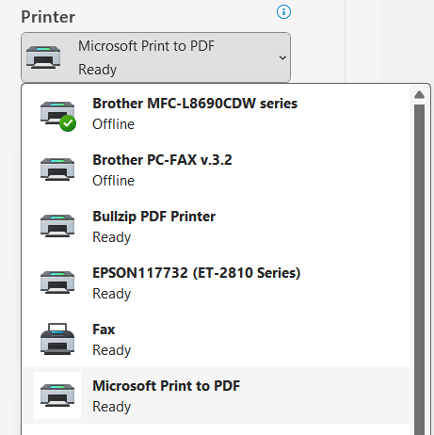

Slide 3
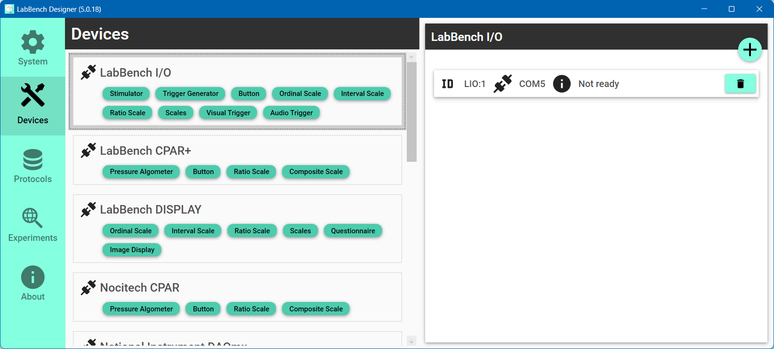

Slide 4

Select the Devices page
Click the “Scan and add” button
Select the type of instrument to add

Slide 5
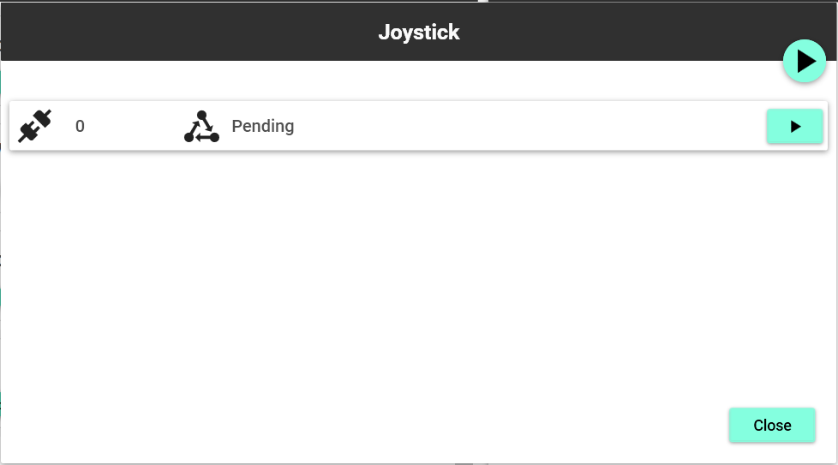
“Scan all connections” button
“Scan connection” button

Slide 6
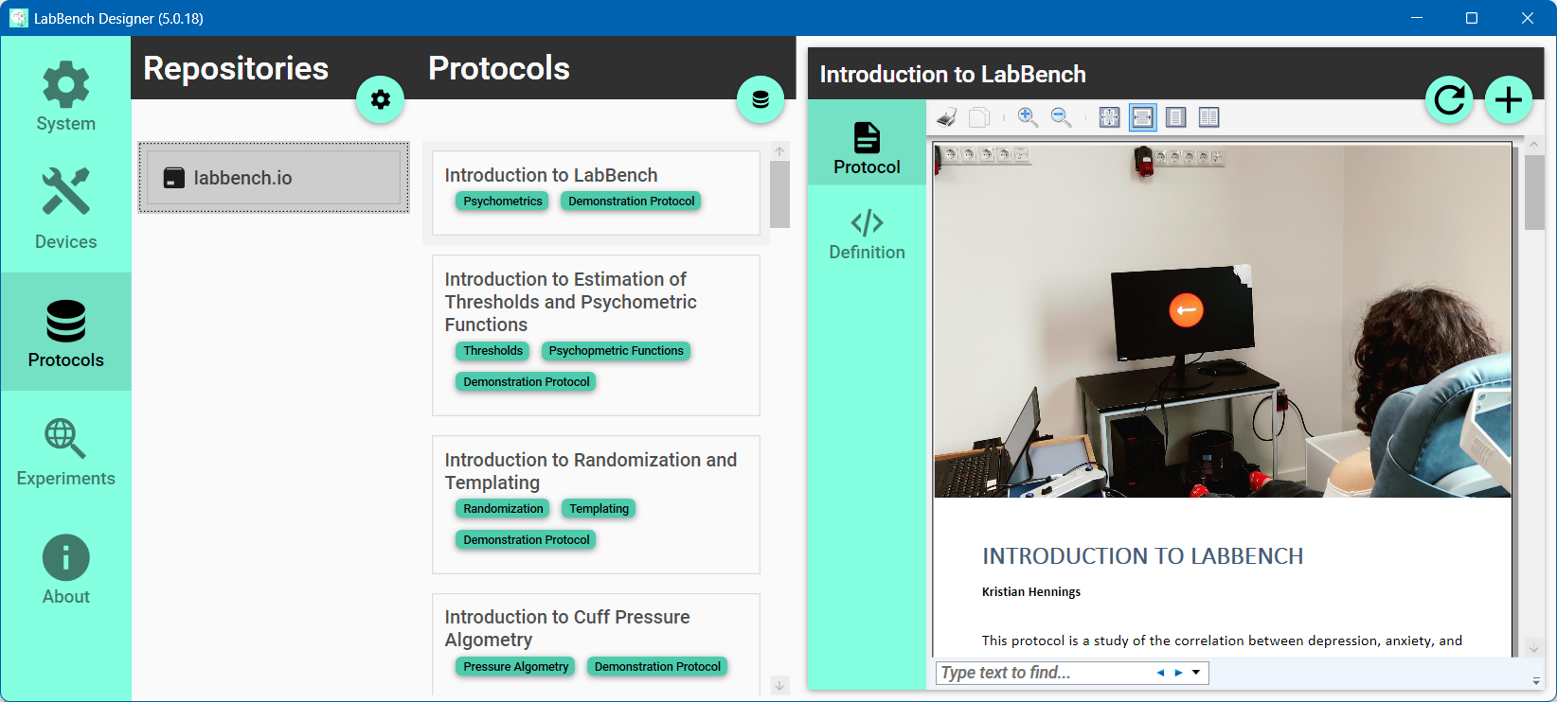
Notes:
Joystick Experimental Setup

